Slide 1
IPWR
(INDIAN PRESSURISED WATER REACTOR)
Dr A B Mukherjee
Ex-Director, RPG, BARC
Distinguished Scientist & RRF

Slide 2
World electricity generation by fuel
(International Energy Authority)

Slide 3
Challenges of 21st century
Thermal power plant
Global Scenario:
  International policy deliberation is proposing to reduce the level of CO₂ emission for power generation to below 50g/kWh by 2050.
  Currently the global average rate of CO₂ emission by thermal power plant is 500g/kWh.
  About 66 % of electricity is produced by thermal power plants.

Slide 4
Challenges of 21st century
Thermal power plant
Indian Scenario:
  CO₂ emission by thermal power plant : 1000g/kwh.
  Value may jump 20-30% high at user end.
  Currently about 65 % of electricity is produced by thermal power plants.
Mix mode using Nuclear, renewable, hydro and “Carbon Based” is the only option to meet the level of 50g/kWh by 2050.
Nuclear power needs to play a major role like base load plant.

Slide 5
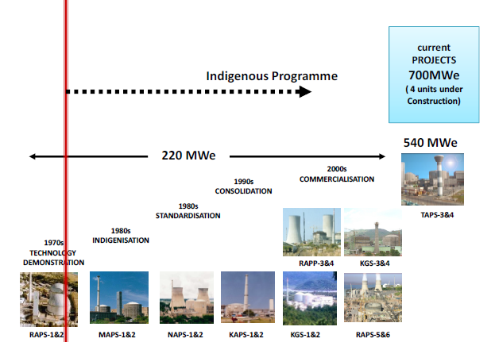
Indian PHWR

Slide 6
INDIAN PRESSURIZED WATER REACTOR (IPWR)
Our Strength :-
Expertise available for design, construction and operation of PHWRs.
Experience gained in commissioning, operating and maintenance of LWRs.
Expertise available for development/ making critical equipment indigenously.
Fuel fabrication technology is well established.
Notes:
6

Slide 7
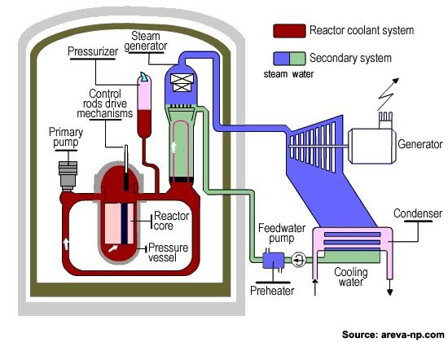
Pressurised Water Reactor
Schematic View of PWR

Slide 8
Pressurised Water Reactor
Only nuclear island is different involving RPV, CRDM, fuel etc.
The design of SG and beyond will remain same and can be adopted from the PHWR technology.
.
Schematic View of PWR

Slide 9
Primary Coolant Circulating Loop of IPWR
RPV : Reactor Pressure Vessel ECCS : Emergency Core Cooling System
RCP : Re-circulating Coolant Pump CVCS : Chemical and Volume Control System
SG : Steam Generator RHRS : Residual Heat Removal System
HPIS : High Pressure Injection System

Slide 10
Approach for IPWR
Conceptual Design of Reactor & Primary systems ( Nuclear island)
Completion of preliminary safety analysis and approval by Regulator
Review and resolution of interfaces
Detail design& development of Systems and components
Development of long lead items like RPV.

Slide 11
IPWR - Salient safety Features
Passive heat removal under prolonged Station Black Out - Plant Autonomy for 7 days
  Air cooled elevated DG set
4 independent trains of Engineered Safety System (like ECCS) with independent power source
  Philosophy for Severe Management Accident
      Hydrogen mitigation
      Containment pressure management (Filtered Hard Vent)
      Core catcher

Slide 12
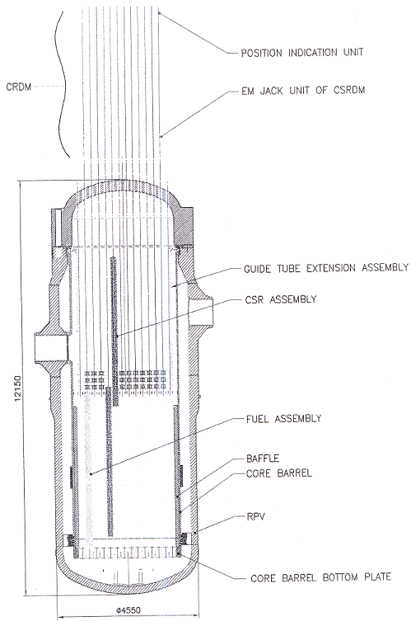
MAJOR DEVELOPMENTS IDENTIFIED
  RPV Forging development
  RPV Fabrication Technology development
  Structural and Thermal Hydraulic Analyses
  Core & Fuel Assembly development
  Control & shut-off Rods & Drive development
  Passive Safety systems development

Slide 13
Development of Low Alloy Steel Forgings for RPV of Indian PWR (IPWR)
Aim is to :
Establish process plans for Melting, Forging, HT & Quality Control
Make prototype scale Forgings
Optimize process plans
Qualify material & technology by comprehensive testing.

Slide 14
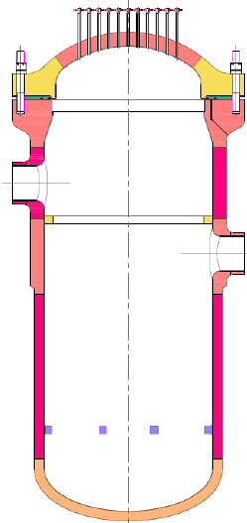
Development of thick low alloy steel forgings for IPWR pressure vessel
Stages
Two forgings to be developed
340 mm thick – represents nozzle portion
750 mm thick – represents flange
750
4500
340
Low alloy steel
Grade – 20MnMoNi55 – equivalent to SA508 Grade 3 Class 1
Quenched and tempered steel (Bainitic steel)
C | Mn | Si | P | S | Cr | Mo | Ni | V | Al
0.15-0.25 | 1.15-1.55 | 0.10-0.35 | 0.008 max | 0.008 max | 0.20 max | 0.40-0.55 | 0.45-0.85 | 0.02 max | 0.01-0.04

Slide 15
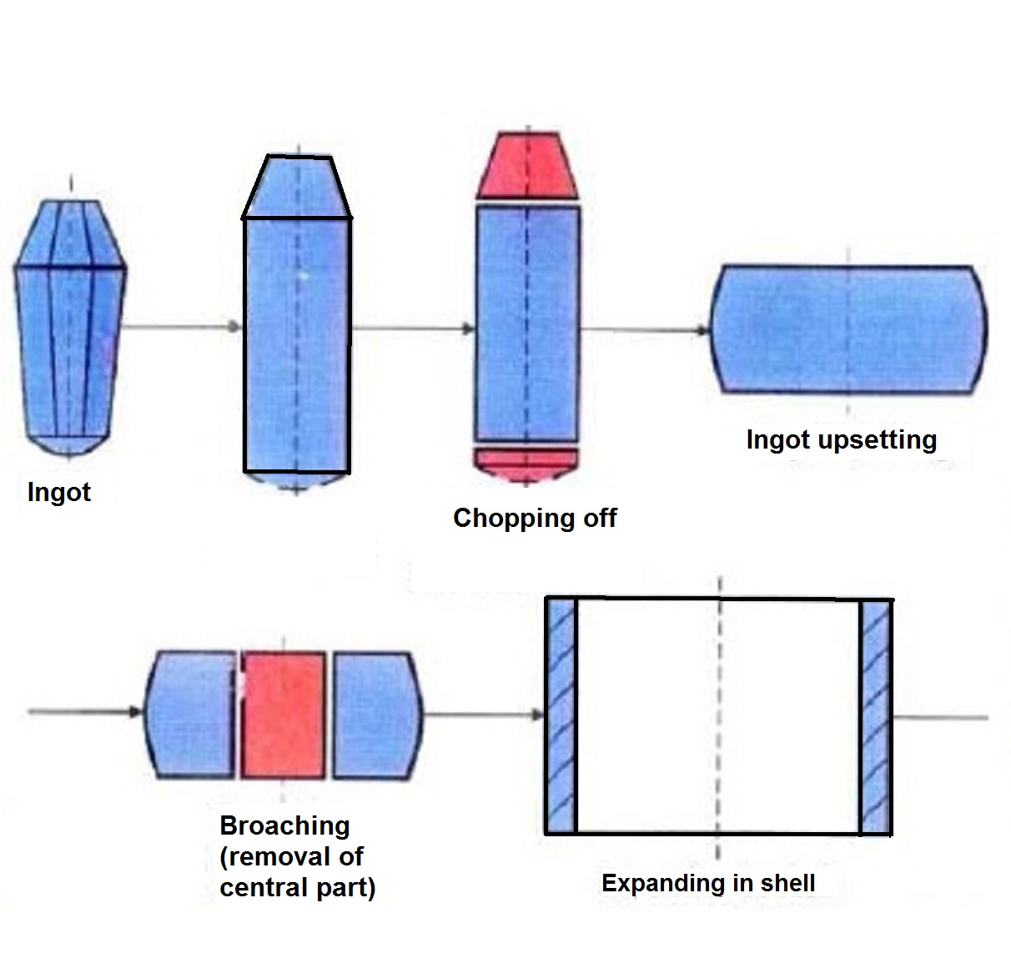
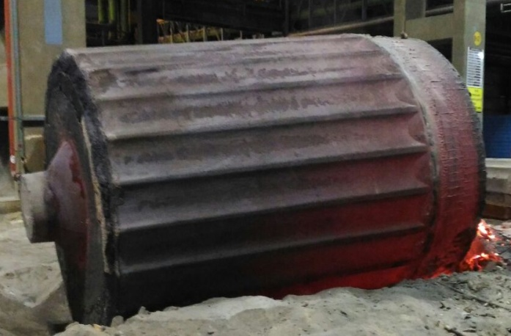
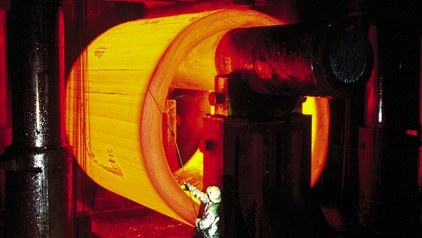
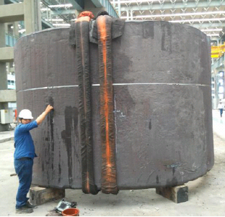
Forging
Forging sequence
Cast Ingot
Ring rolling over mandrel
Final Shell after forging process

Slide 16
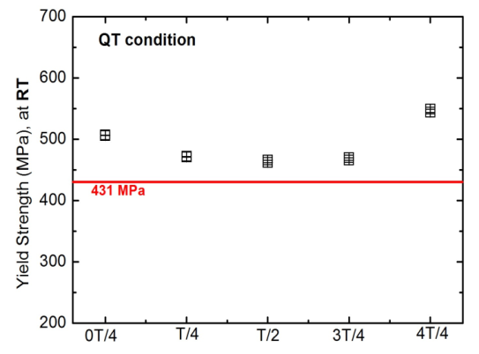
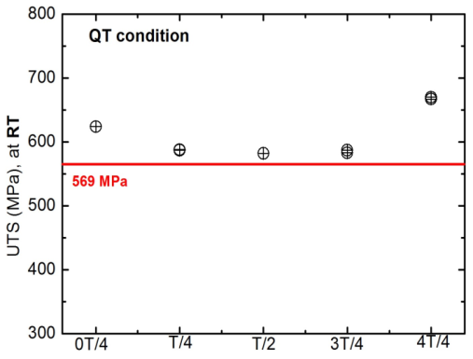
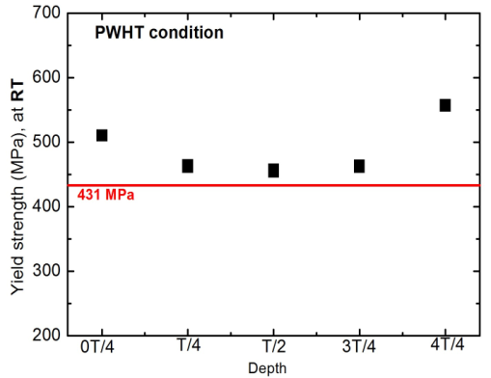
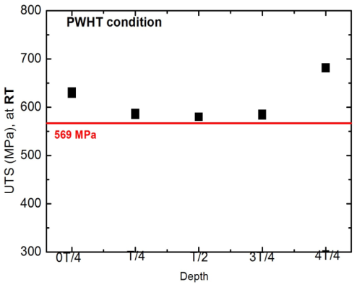
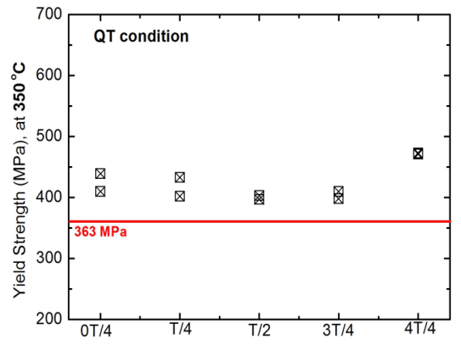
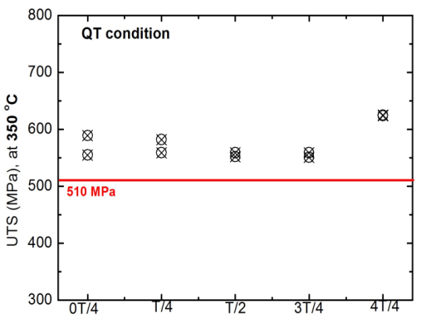
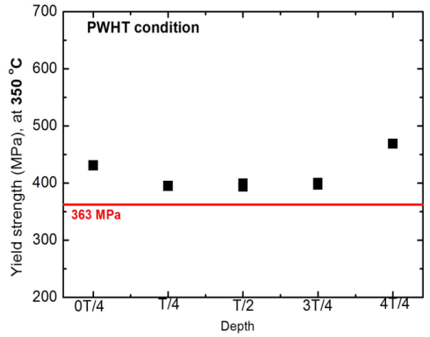
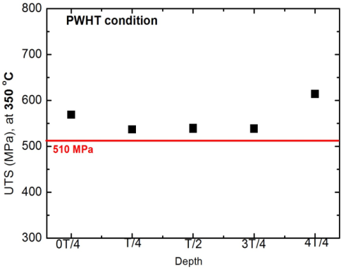
Through thickness tensile test
Location : Through thickness, 0T/2, T/4, T/2, 3T/4 and 4T/4
Direction : Axial
QT
PWHT
YS
UTS
YS
UTS
RT
350
All through thickness tensile tests results meet the requirements

Slide 17
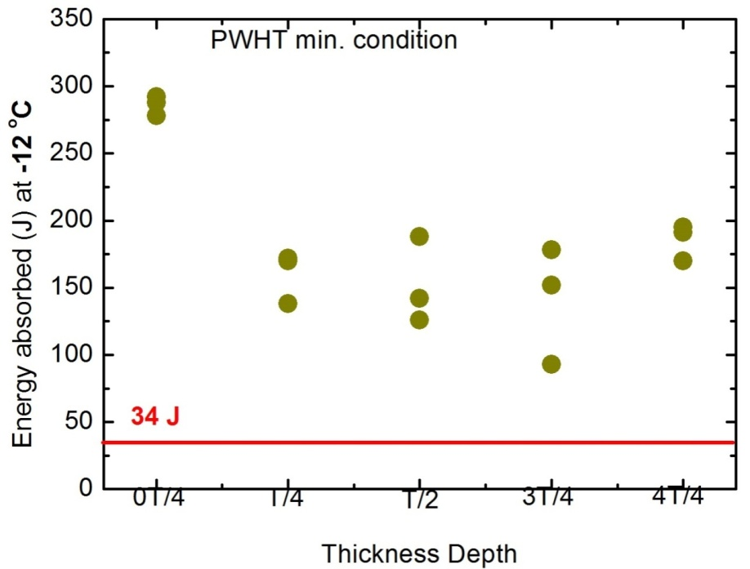
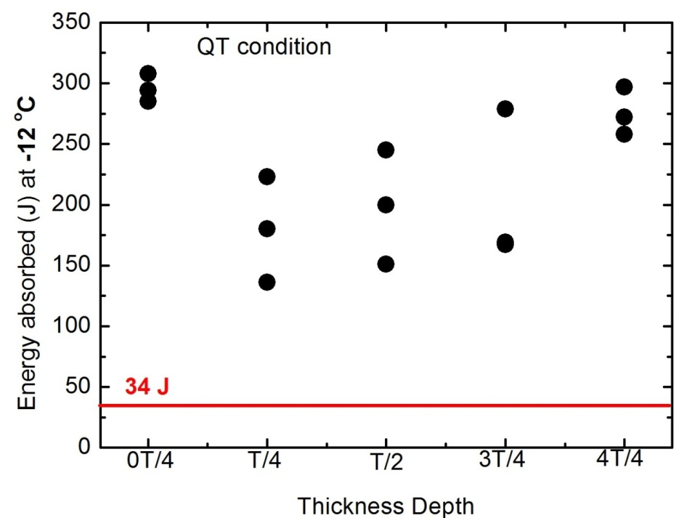
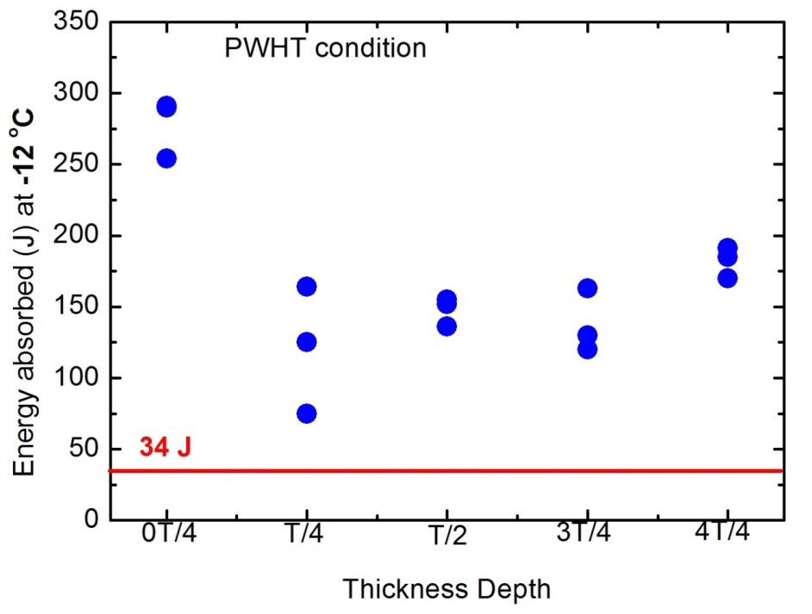
Through thickness charpy “V” notch impact test
Through thickness impact test
Direction – Axial
Temperature- -12ºC
PWHT max condition
All through thickness impact test results meet the requirements

Slide 18
Challenges of IPWR
Cost reduction
  completing greater portions of the detailed design prior to construction involving manufacturers.
  using a proven supply chain from PHWR series
  Compensation for low Carbon attributes.

Slide 19
CONCLUSIONS
Indian PHWR program has demonstrated the maturity achieved in the research, design, development and successful commercial deployment of nuclear technology in the country.
Along with imported Light Water Reactors (LWRs) , India has also initiated activities related to development of indigenously designed PWRs to meet the country’s immediate energy demand.
India’s Nuclear Power Program needs to play important role to achieve CO₂ limit of 50g/kwh.

Slide 20
THANK YOU

Slide 21
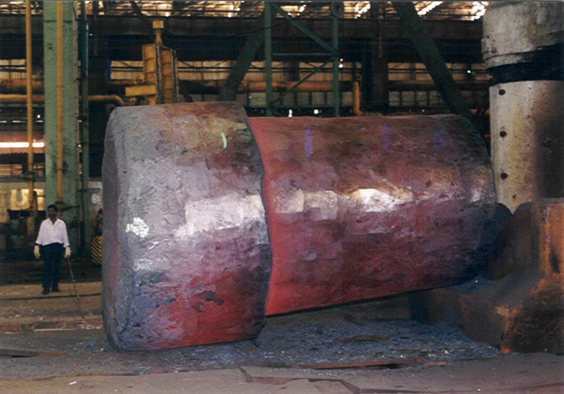
RPV FORGING DEVELOPED BY RPG/BARC
LAS forgings (Cr-Mo-V Class)
Developed indigenously at HEC, Ranchi
Largest size developed first time within the country – 120 T ingot
Fabrication Technology for vessel developed & deployed on the project
Shell Forging
Bottom Dished Head

Slide 22
PWR Programme in India
Operating LWRs based on foreign technical cooperation
    GE- BWR (TAPS-1&2)
    VVER (KK-1 )-PWR
Planned PWRs based on foreign technical cooperation
    VVER
    AP1000
    EPR
Indigenous design and development of PWR
    Indian PWR (IPWR), a joint project of BARC & NPCIL

Slide 23
IPWR : Plant Specification
General plant data
Reactor thermal output : 2700 MWth
Design pressure :17.7 MPa
Design temperature : 350 °C
Service life : 60 calender years
Primary heat transport system data
Primary coolant flow rate : 76,700 m3/h
Reactor operating pressure : 15.7 MPa
Average temperature of Coolant : 308 °C
No. of loops : 4 (one vertical SG and one PCP in each loop)

Slide 24
Accident Scenarios Considered
SBO-after Safe Shut Down
Passive Decay Heat Removal System (PDHRS)
LOCA- after Safe Shut Down
Emergency Core Cooling System (ECCS)
BDBA
Corium Retention and Core Catcher System

Slide 25
International Energy Authority-15

Slide 26
Electrical power as on March-2018 ( Report CEA-18)
Energy Source | MW | % of total
Coal | 222907 | 64.8
nuclear | 6780 | 1.97
hydro | 45293 | 13.17
Renewable ( Wind, small hydro, solar etc) | 69022 | 20
Total | 344002

